Slide 1
Competition Task_Sprint2
Shreya Raina

Slide 2
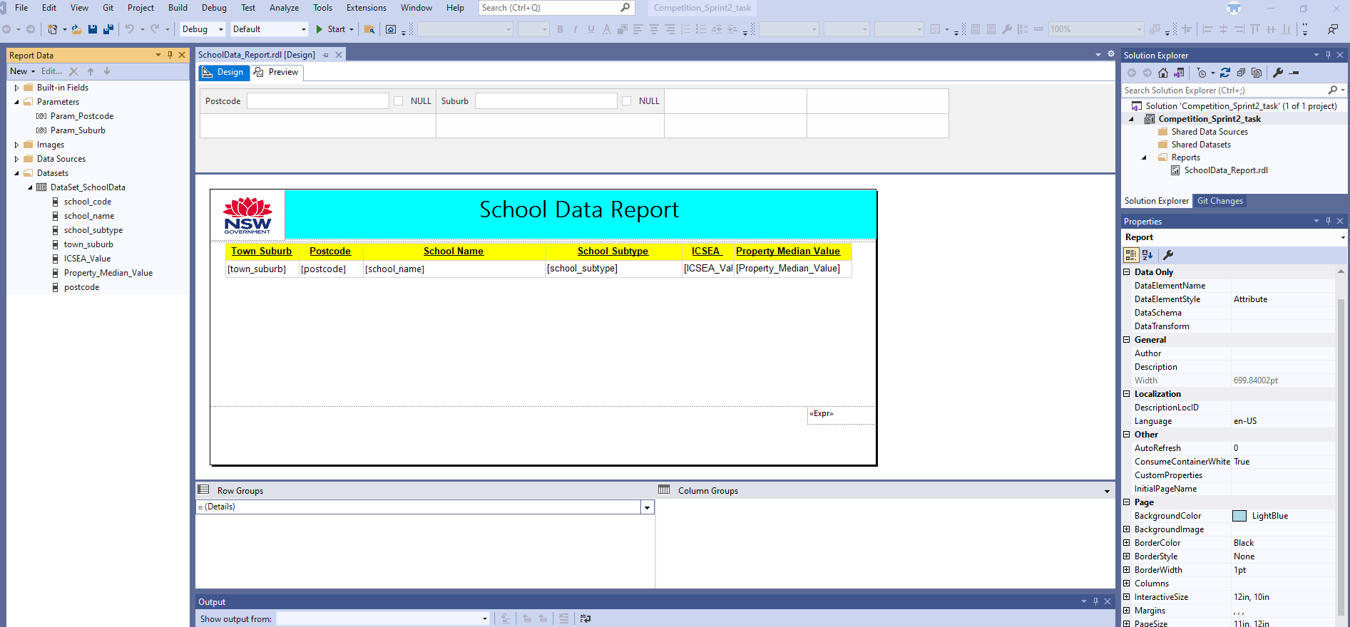
SSRS Report with details and parameters

Slide 3
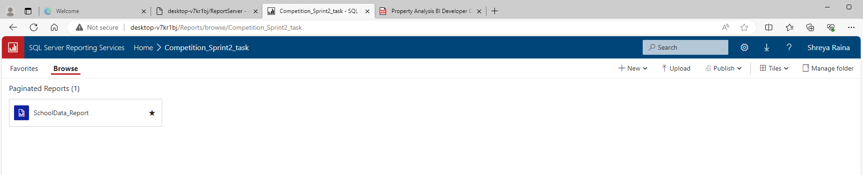
Published SSRS report into your web portal

Slide 4
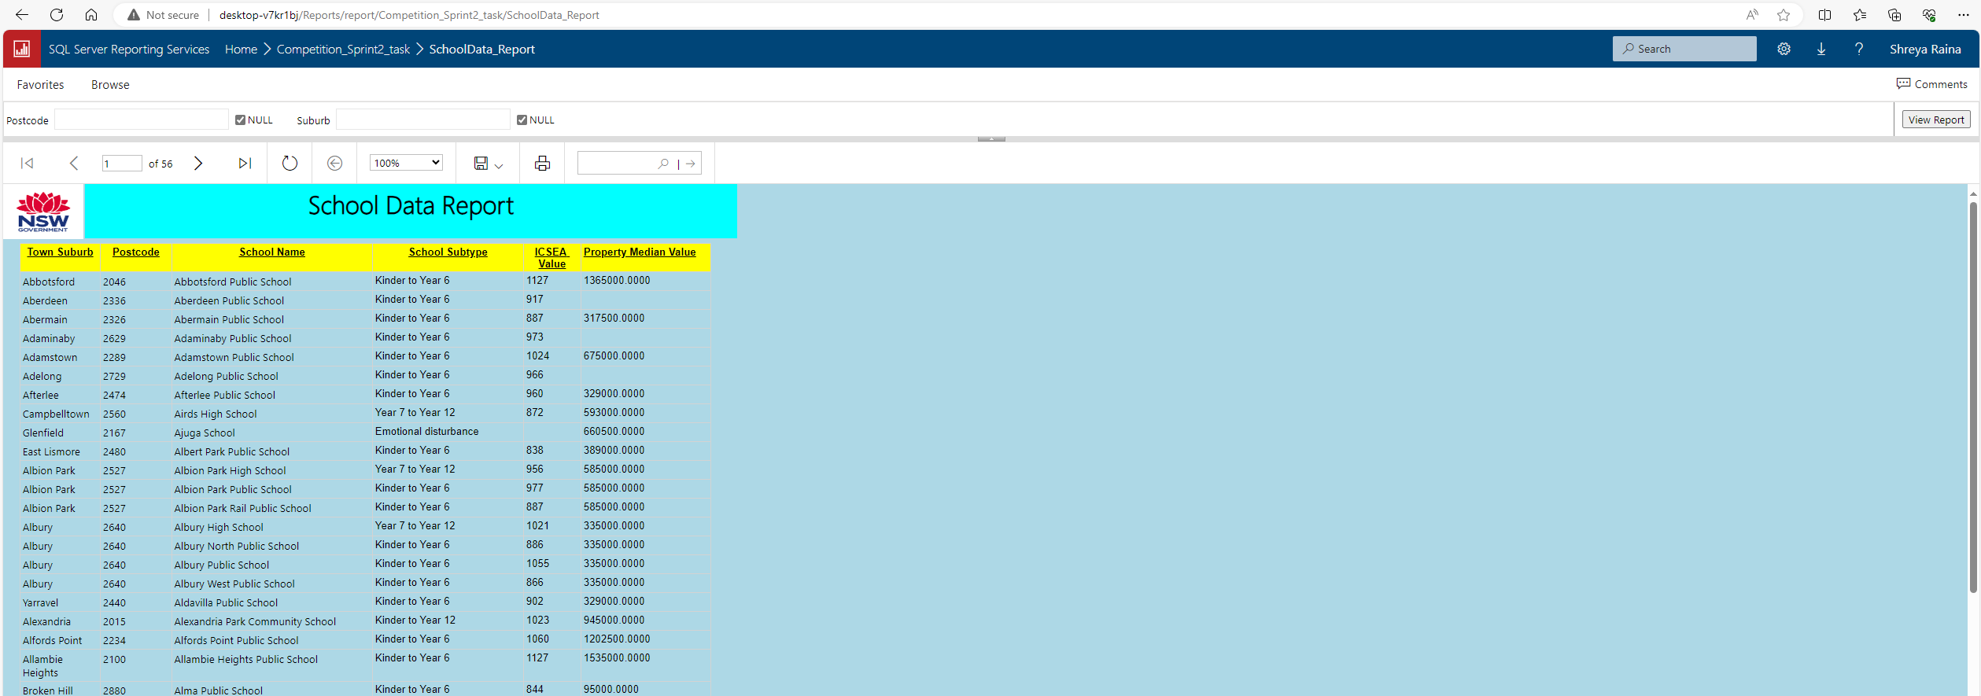
Report to be used by the user from web portal

Slide 5
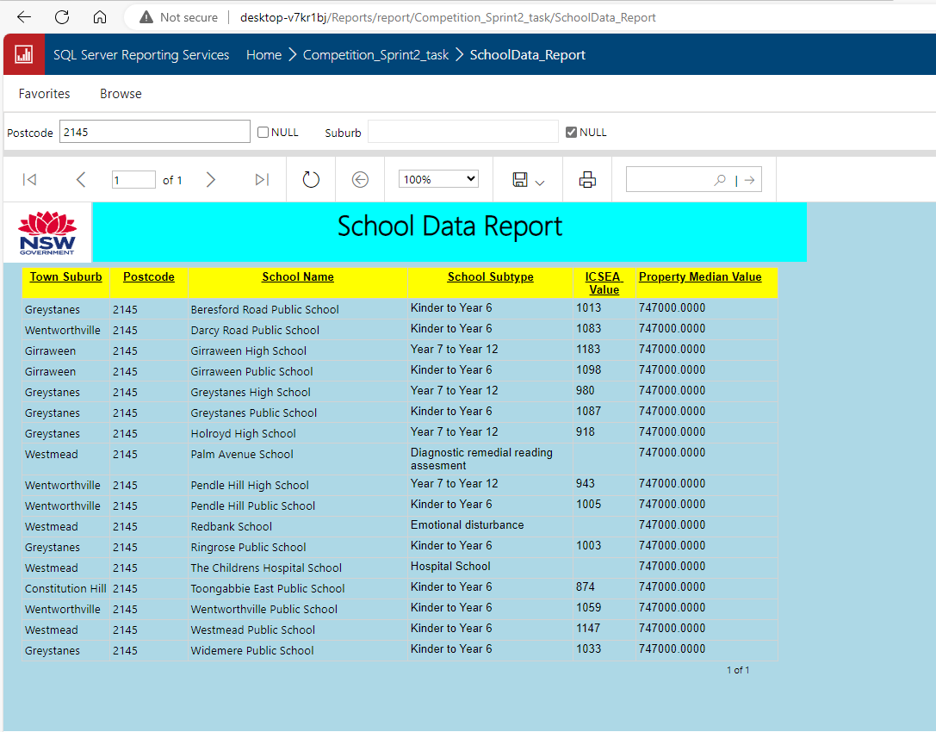
Drilling through Parameters on web portal

Slide 6
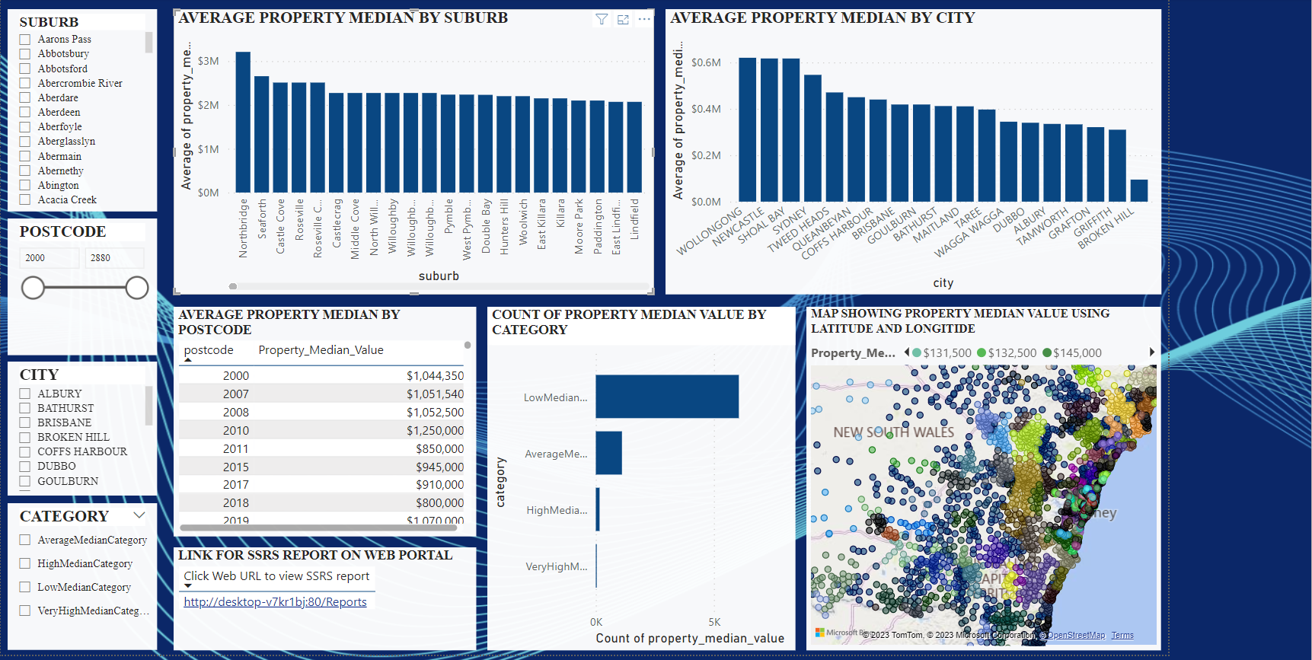
Power Bi Report

Slide 7
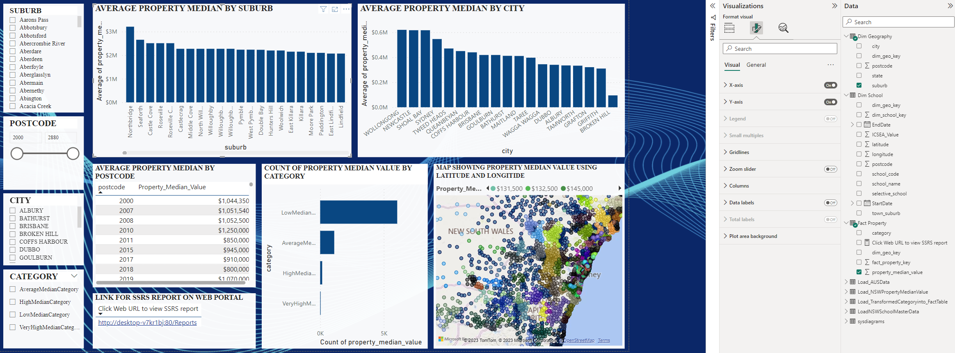
Create a link in Power BI report, and when users click the link, it will jump into the browser and open the above SSRS report

Slide 8
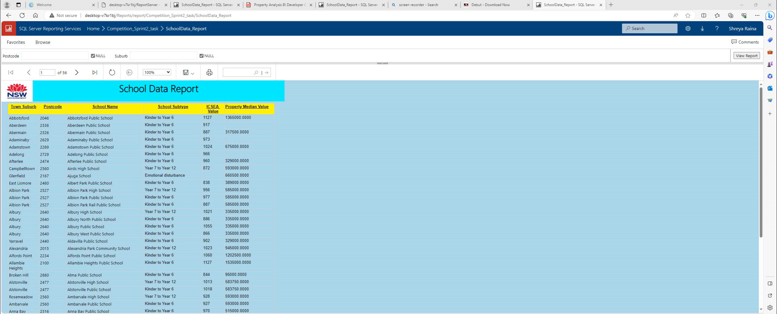
PLEASE CLICK ON THE SCREENSHOT TO PLAY THE RECORING TO OPEN THE SSRS REPORT ON WEB PORTAL FROM POWER BI. CAN SEE THE PLAY BUTTON IN FRONT OF THE BLUE ARROW.

Slide 9
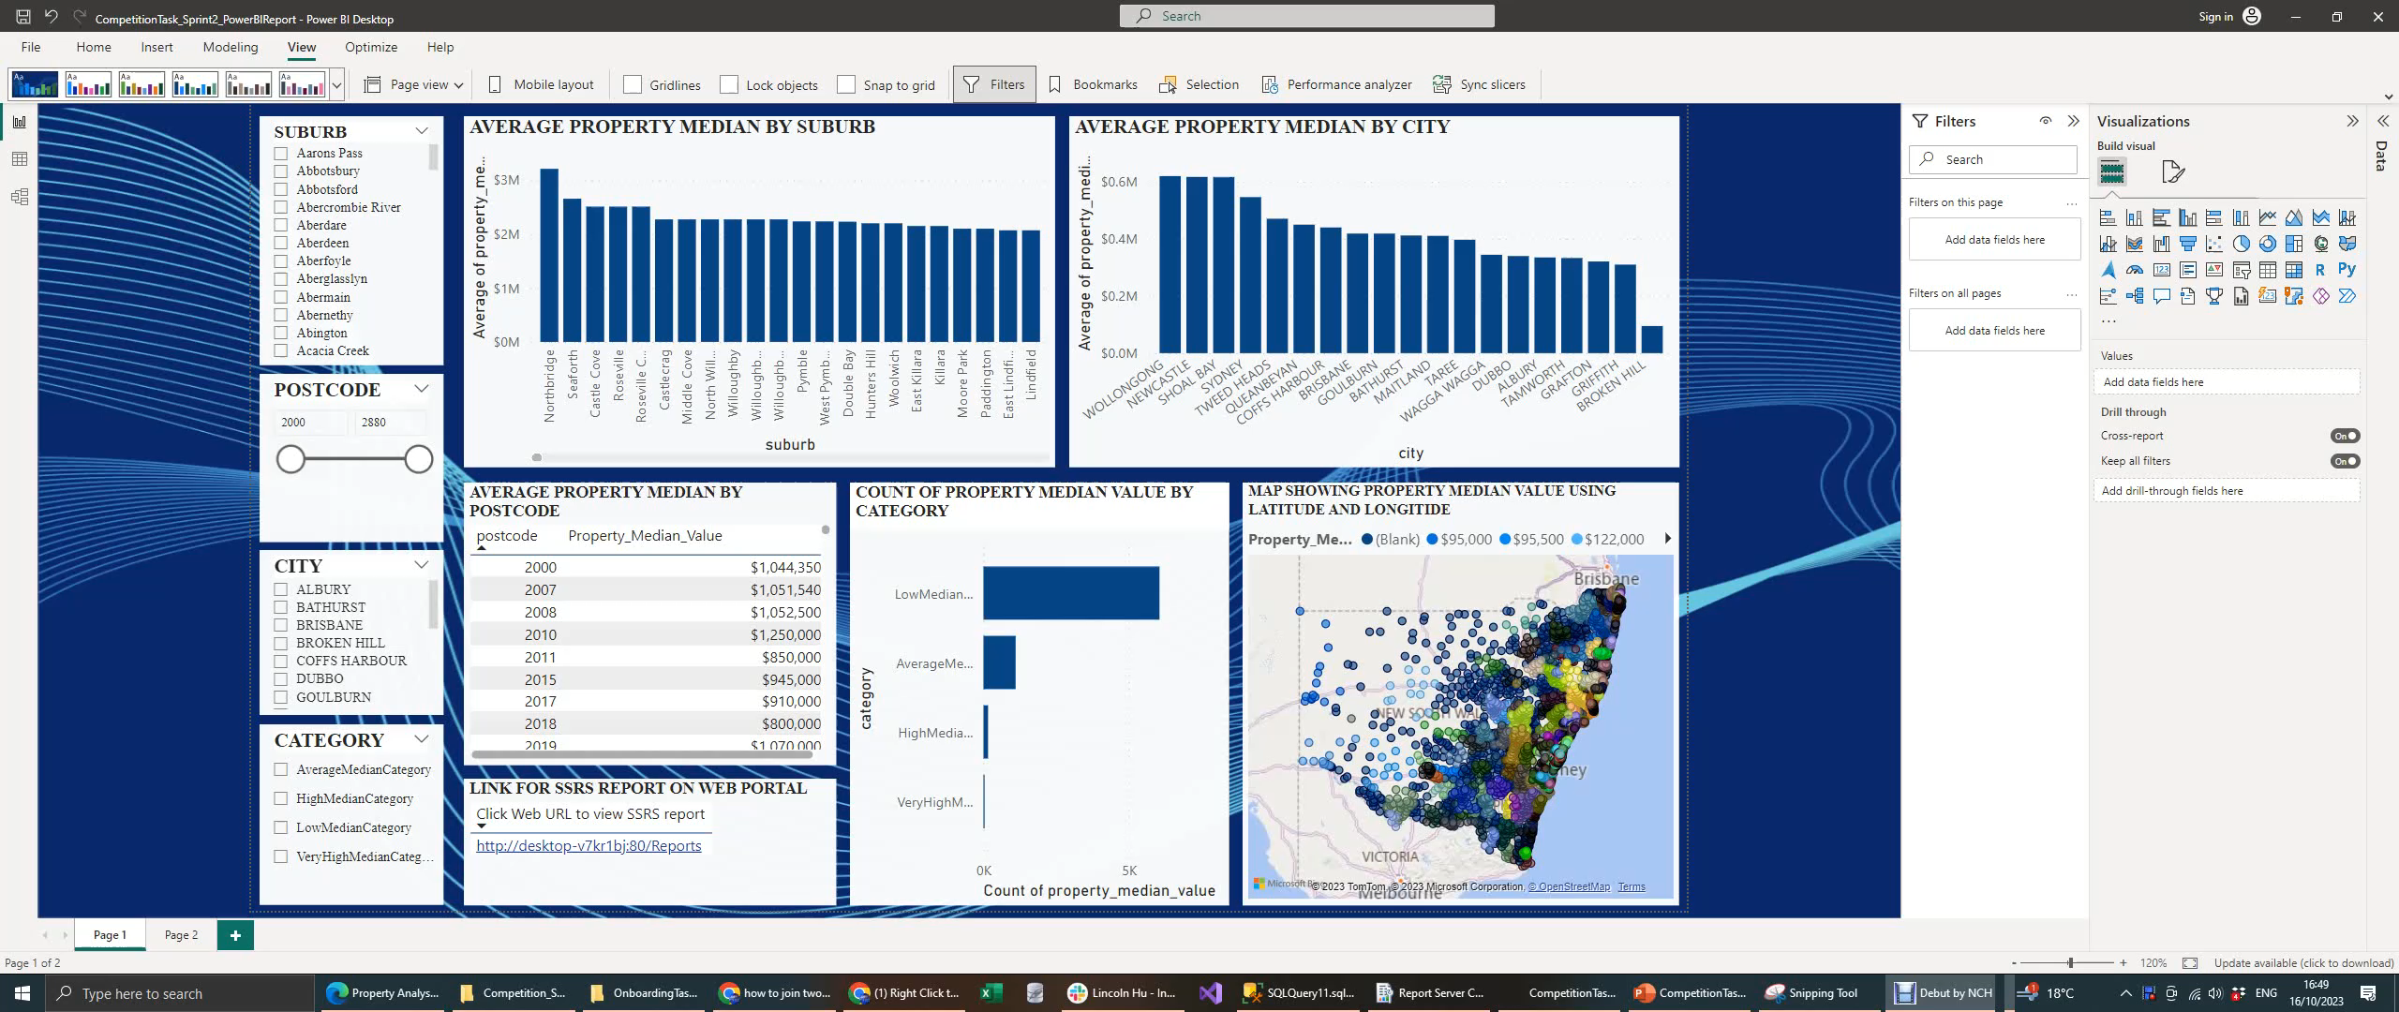
PLEASE CLICK ON THE SCREENSHOT BELOW TO PLAY THE RECORING FOR THE DRILL THROUGH FUNCTION , CAN SEE THE RECORD BUTTON IN FRONT OF BLOW ARROW.

